Slide 1


Alexandria and Climate Change Mitigation:
Eco-City Alexandria’s Energy Strategy
Moving Northern Virginia Forward to Combat Climate Change
An Energy Efficiency Forum
October 1, 2014
Bill Eger
Energy Manager
City of Alexandria

Slide 2
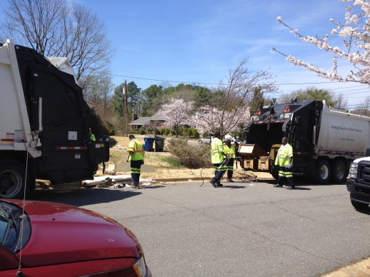
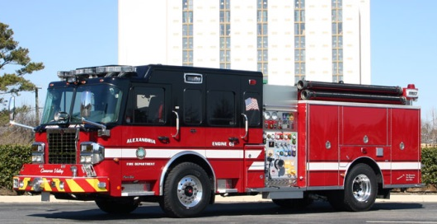

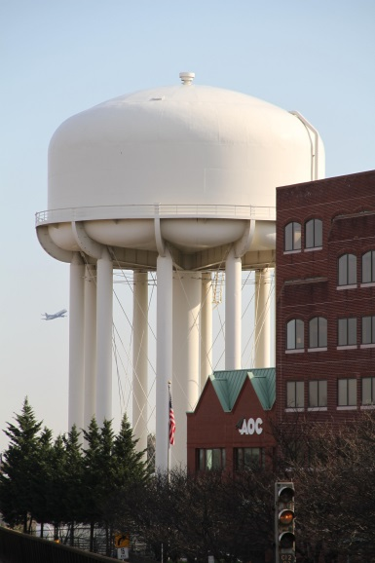
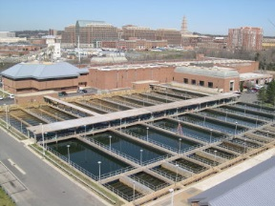
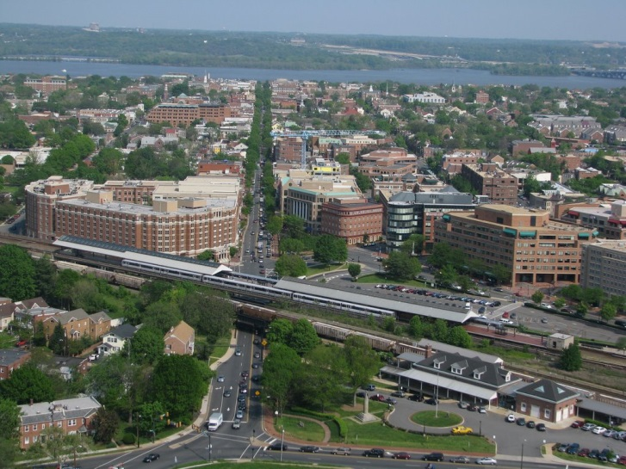
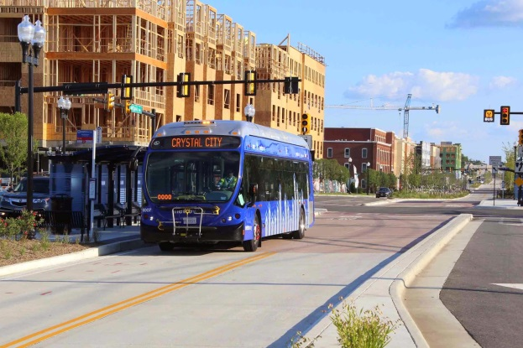
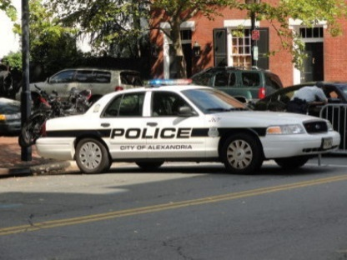
energy makes modern cities possible

Slide 3
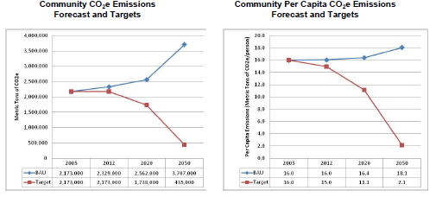
cities face many threats and challenges of climate change

Slide 4
“sustainable* energy makes future cities possible”
*Energy efficiency, renewable energy, clean energy

Slide 5
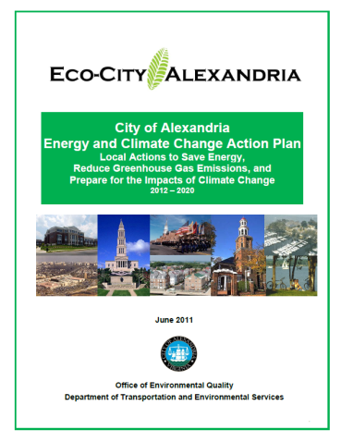

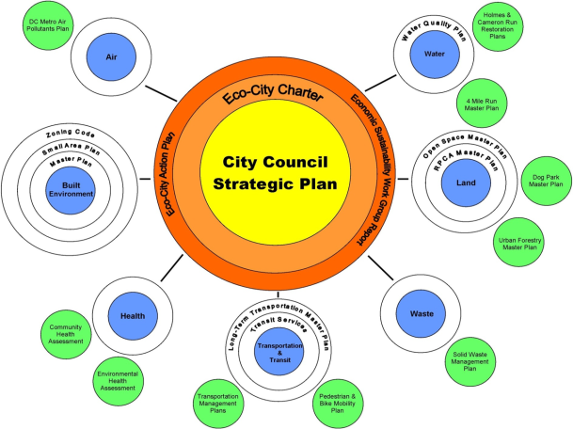


Slide 6
City of Alexandria
Office of Energy Management
City Government Energy Management
Community Energy Management
Utility Procurement & Management
Energy Assurance & Reliability
Energy Regulatory and Policy Affairs
Electrical Infrastructure Management

Slide 7
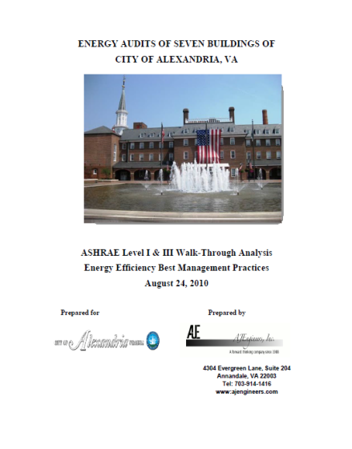
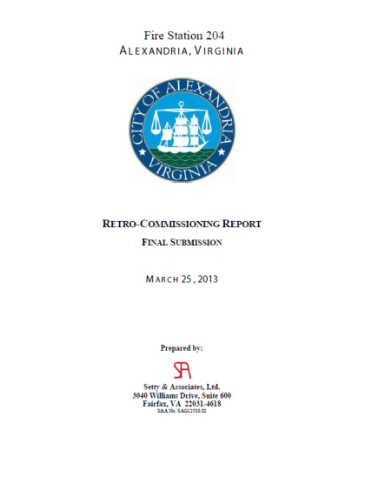
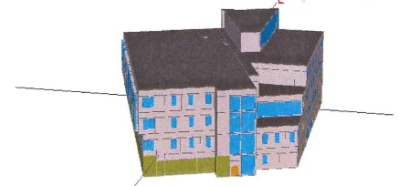
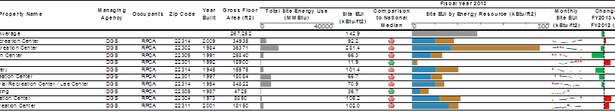
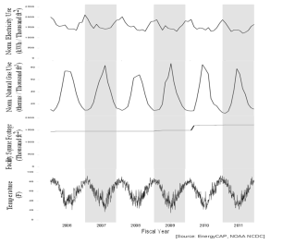
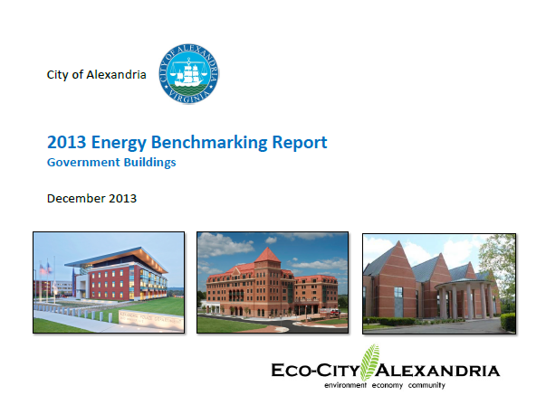
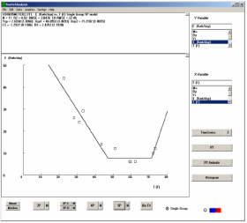
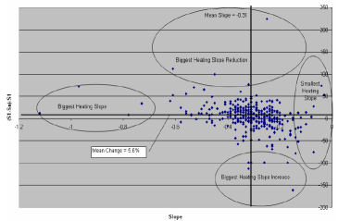
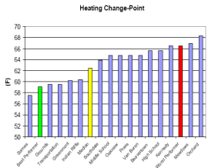
City Government Actions

Slide 8
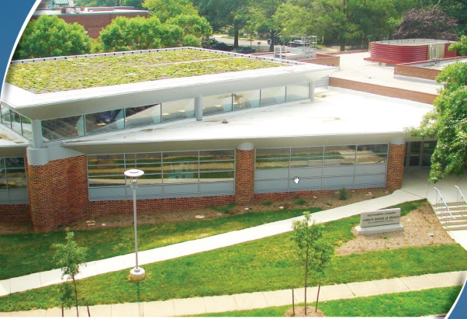
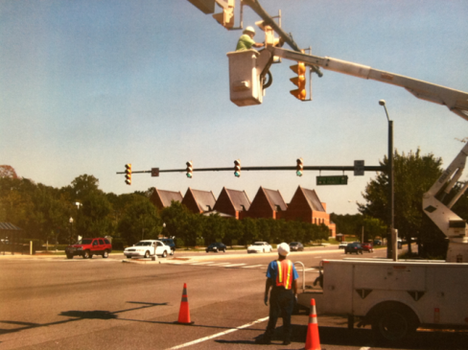
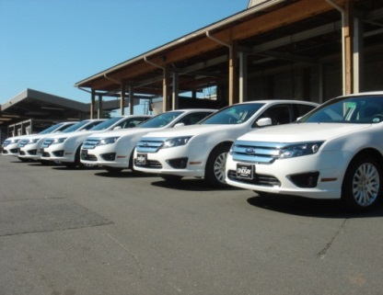
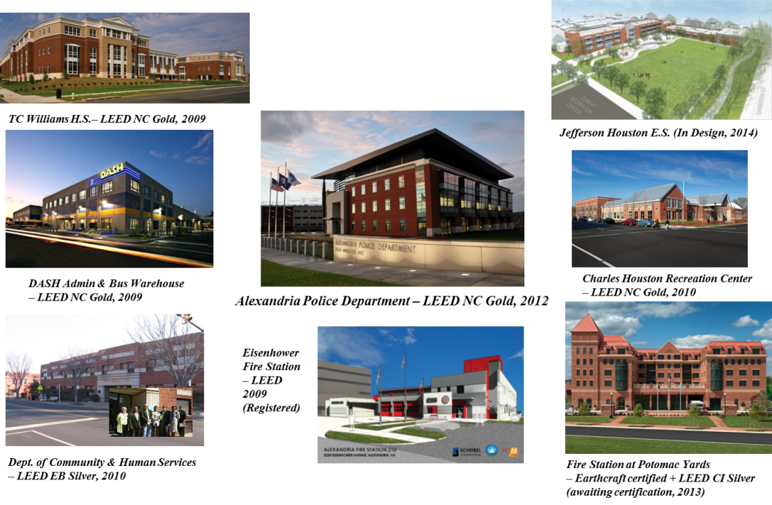
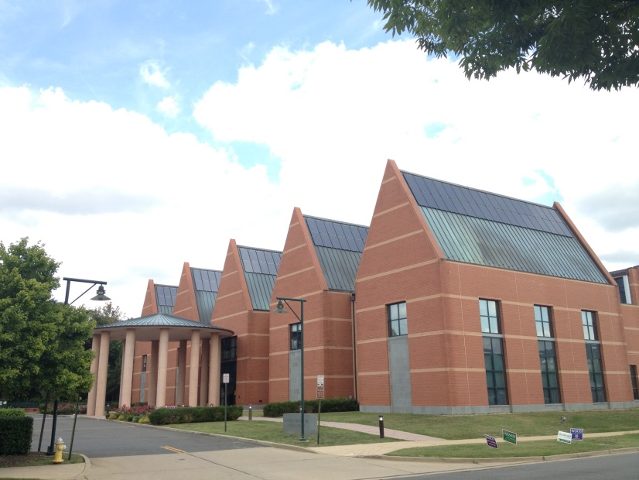
City Government Actions

Slide 9

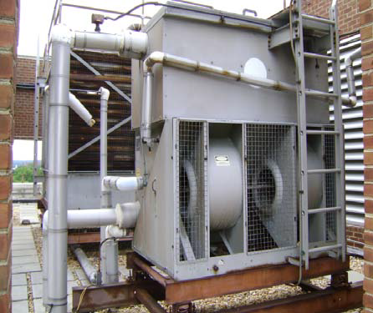

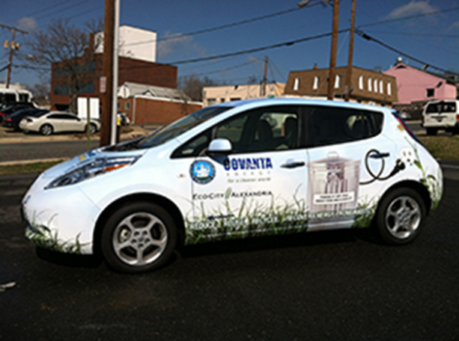
City Government Actions

Slide 10



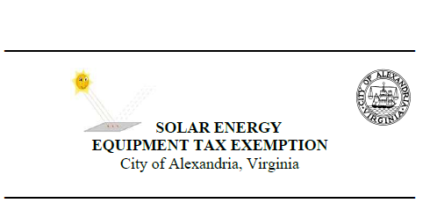




Community Actions

Slide 11

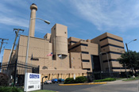


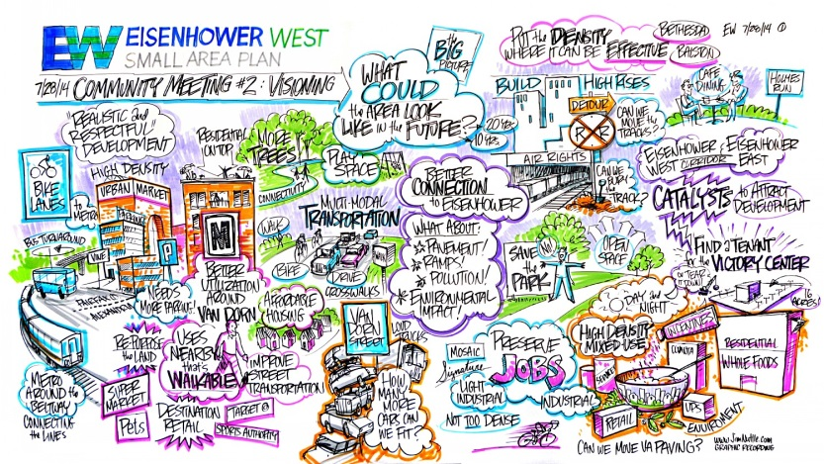

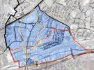

Community Actions

Slide 12
Continued Efforts
City Operations
Lighting retrofits
High-efficiency HVAC retrofits
Re- and retro-commissioning
Facility Advanced Metering Infrastructure (fAMI) and Enterprise BMS Control
Solar photovoltaic systems
Green fleet policy and implementation
Electric vehicle charging stations
Street-, traffic-, and park-lighting retrofits
FY2014 Annual Energy Review & Benchmarking Report
“OpenData” Portal for energy-use data & disclosure
Community Programs
Green Building Policy Updates
Environmental Action Plan Updates
LGOP & Community Greenhouse Gas Emission Inventory updates
Alexandria Home Performance with Energy Star neighborhood targeting
Small Area Plan Eco-districts & District Energy systems
City Energy Efficiency Scorecard
Energy Efficiency and Renewable Energy Workshops
Carbon Disclosure Project Reporting

Slide 13
Bill Eger
Energy Manager
City of Alexandria
bill.eger@alexandriava.gov
http://www.alexandriava.gov/eco-city
Photo sources available by request

